Slide 1

3rd Trans-Tasman Cup Wairakei Golf and Sanctuary, Taupo 8-14 February 2025

Slide 2
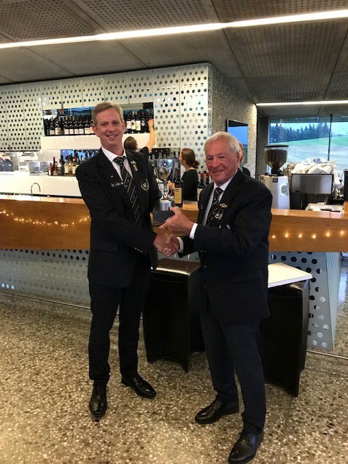
Team New Zealand
Team Australia
14 Players
14 Players

Slide 3

HISTORY OF THE TRANS-TASMAN CUP
As far back as early 2000, Ray Parsons and Wayne Richardson discussed options to bring Australia and New Zealand Nomads closer. In 2015 Mark Howard-Browne (Aus) and Rob Jones (NZ) discussed a tournament between the two countries. Wayne Scholtz joined the NZ committee in 2019, and continued discussions with Mark at the Australian Nationals in 2021. Wayne and Mark involved Nell Schoeman and between Wayne and Nell, they were able to motivate both National committees to establish the first Trans-Tasman Tournament in 2023 in New Zealand. The inugral tournament was held at Millbrook in Queenstown with each team sending 12 players under leadership of Captains Ray Parsons (NZ) and Chris Fichardt (Aus). Nell Schoeman organised the 2024 Tournament at The Mornington Peninsula. Team New Zealand currently lead the series 2-0.
The Trans-Tasman trophy was sponsored by Ray Parsons.
2025 will host 14 players from each Nation.

Slide 4

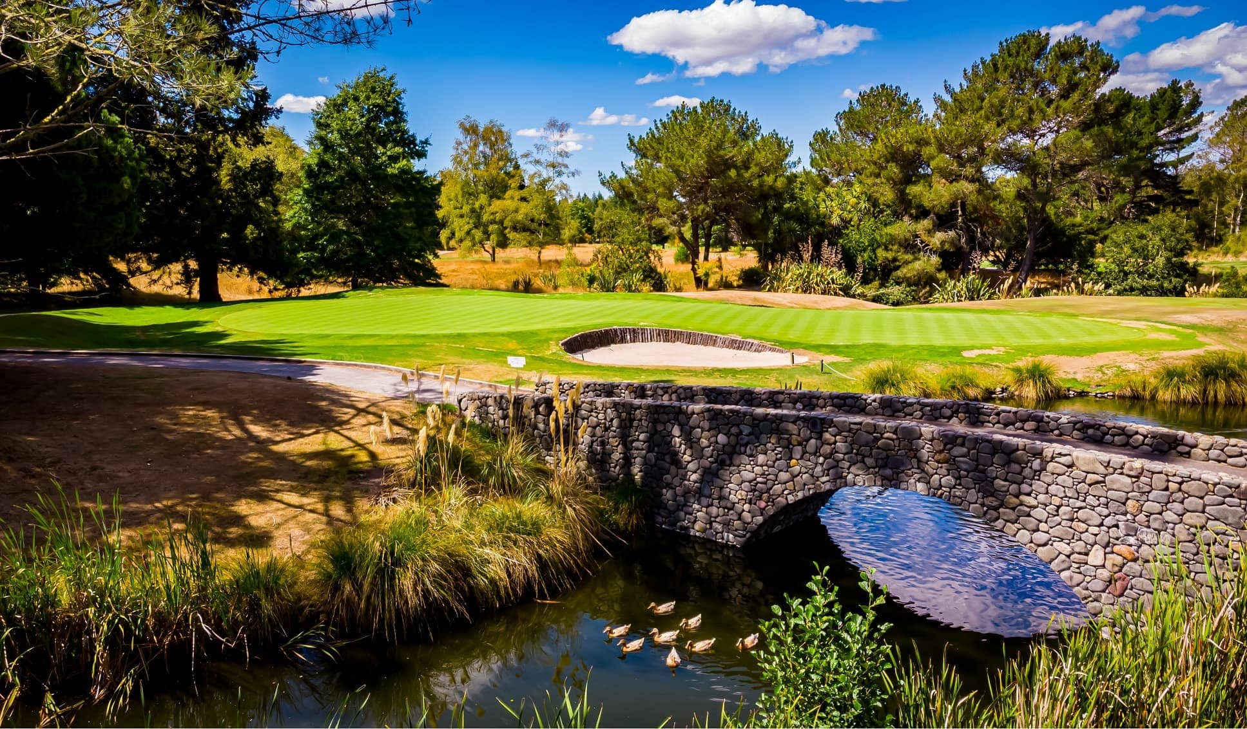
2025 HOSTING VENUE – Wairakei Golf and Sanctuary Estate
The hosting venue for the 2025 Trans-Tasman Cup is Wairakei Golf and Sanctuary in Taupo, North Island, New Zealand.
The course opened in 1970 and the basic layout of the golf course remains true to the original design of Commander John Harris, Michael Wolveridge and Peter Thomson. The current owner, Gary Lane has continued the drive to provide a world class golfing experience. There have been many enhancements to the golf course environment including a strong focus on conservation and providing a predator free sanctuary for wildlife.

Slide 5

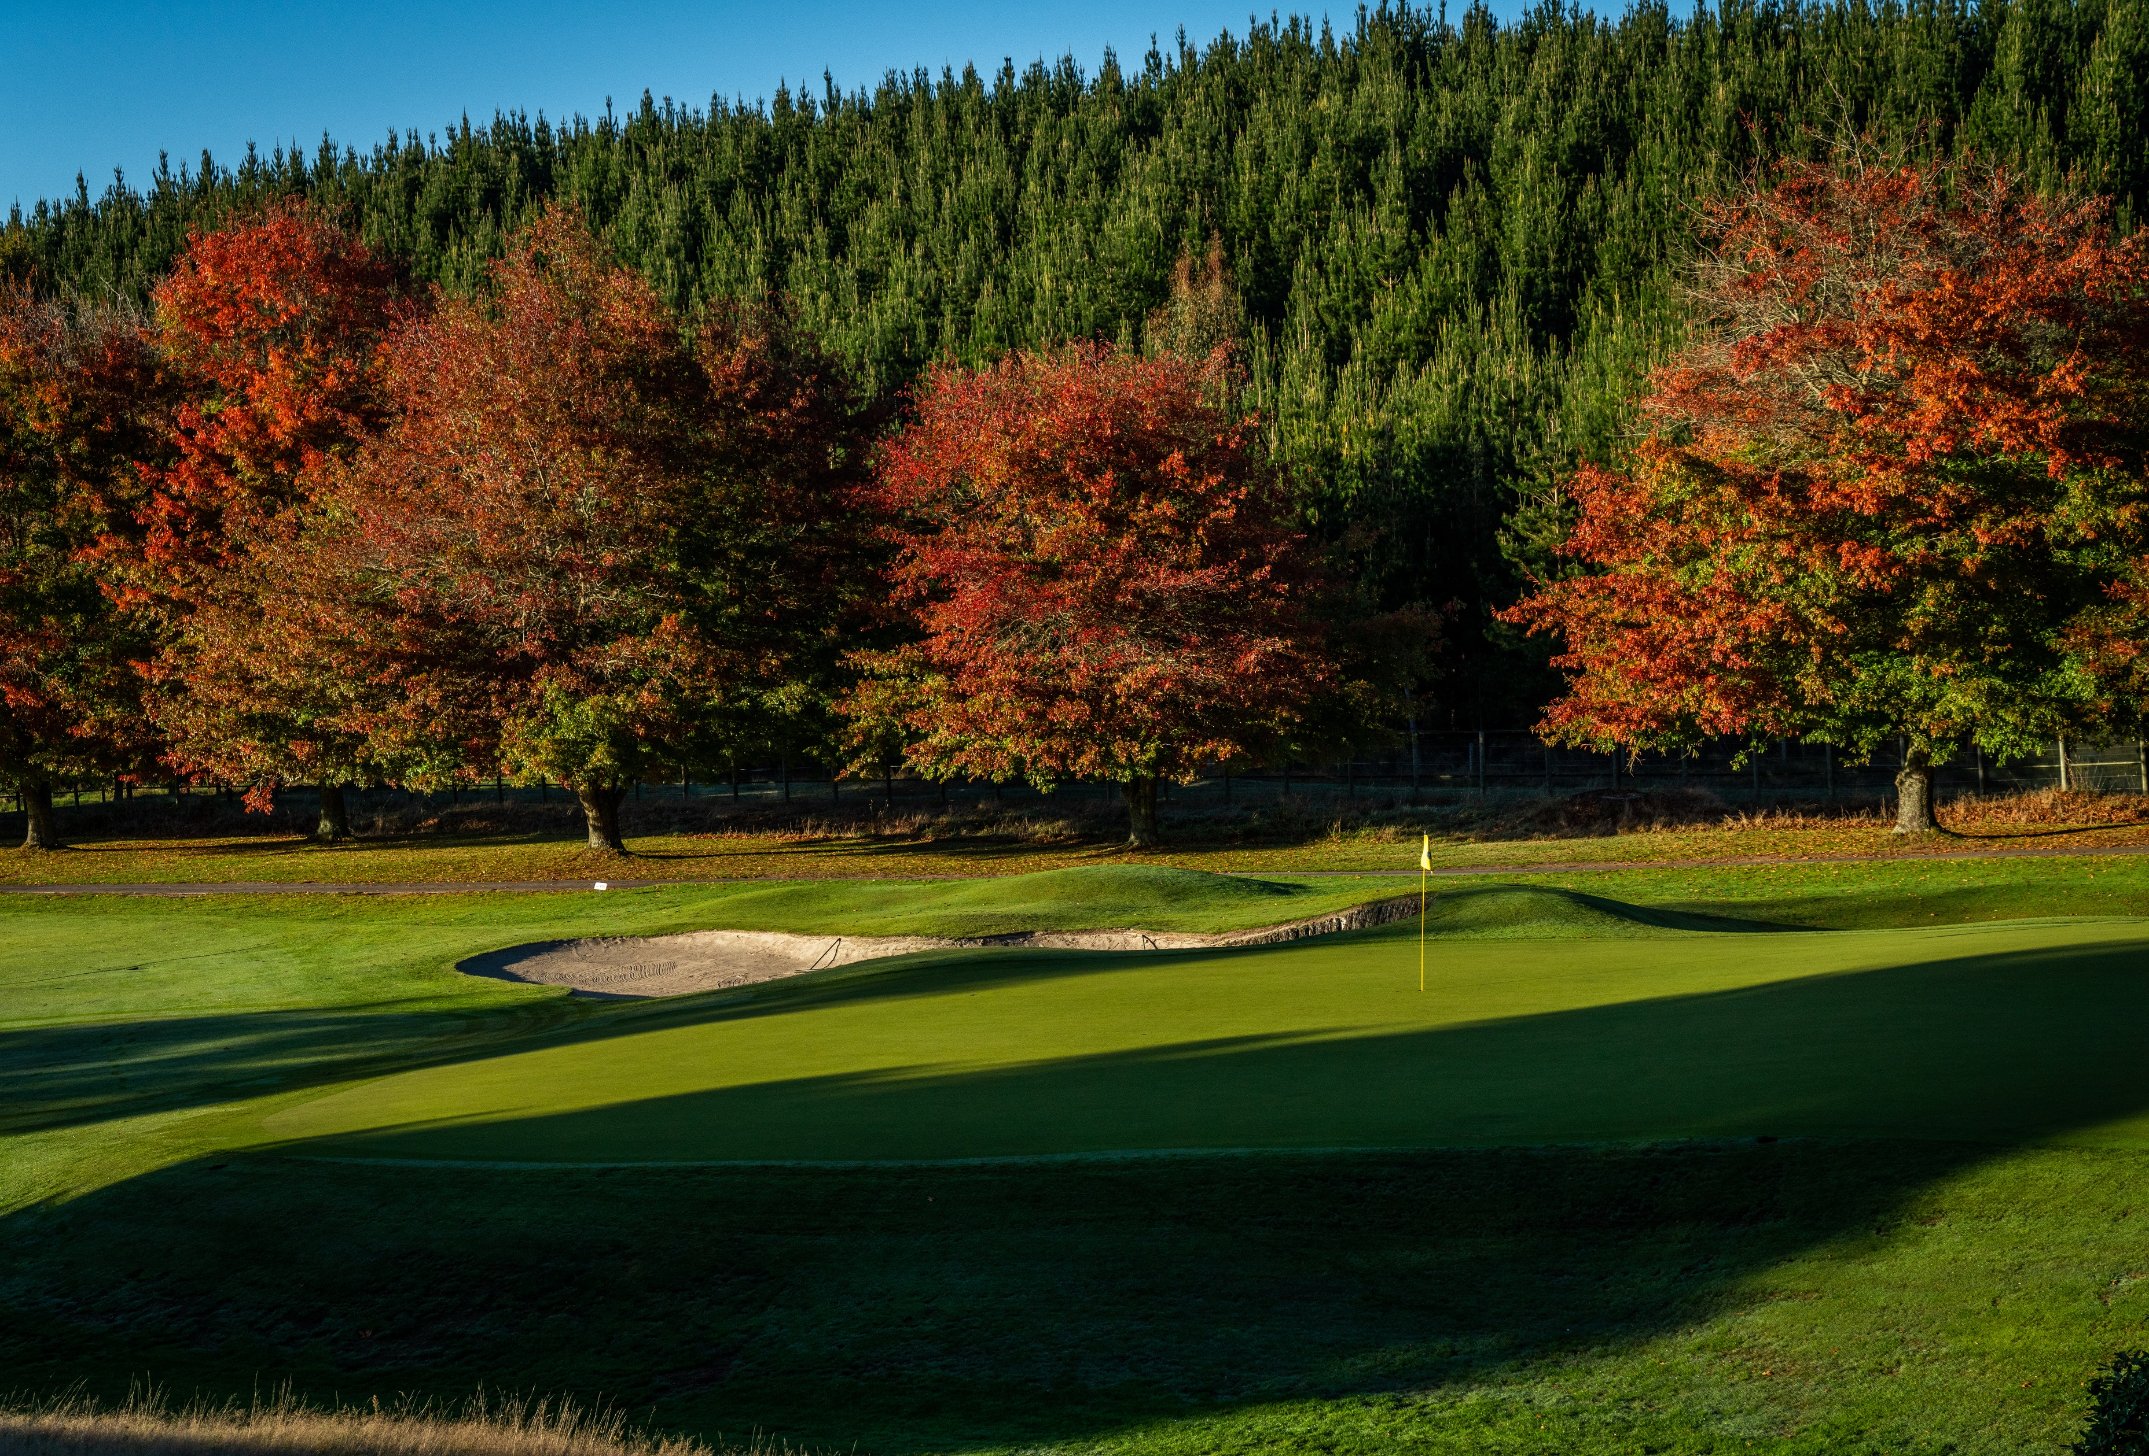
SATURDAY 8TH FEBRUARY
After arriving into Auckland we all depart for Taupo which is around a 4 hour drive. Saturday night will be a casual night and an opportunity to rekindle the Trans-Tasman rivalry.
Our accommodation for the 6 nights is The Millenium Hotel in Taupo on a Single or twin share basis. Your package will include breakfast every morning, dinners on 4 nights and 5 rounds of golf including carts at all courses. Tour hosting courses are the Wairakei Sanctuary and the Jack Nicklaus Signature Kinloch Golf Course.

Slide 6
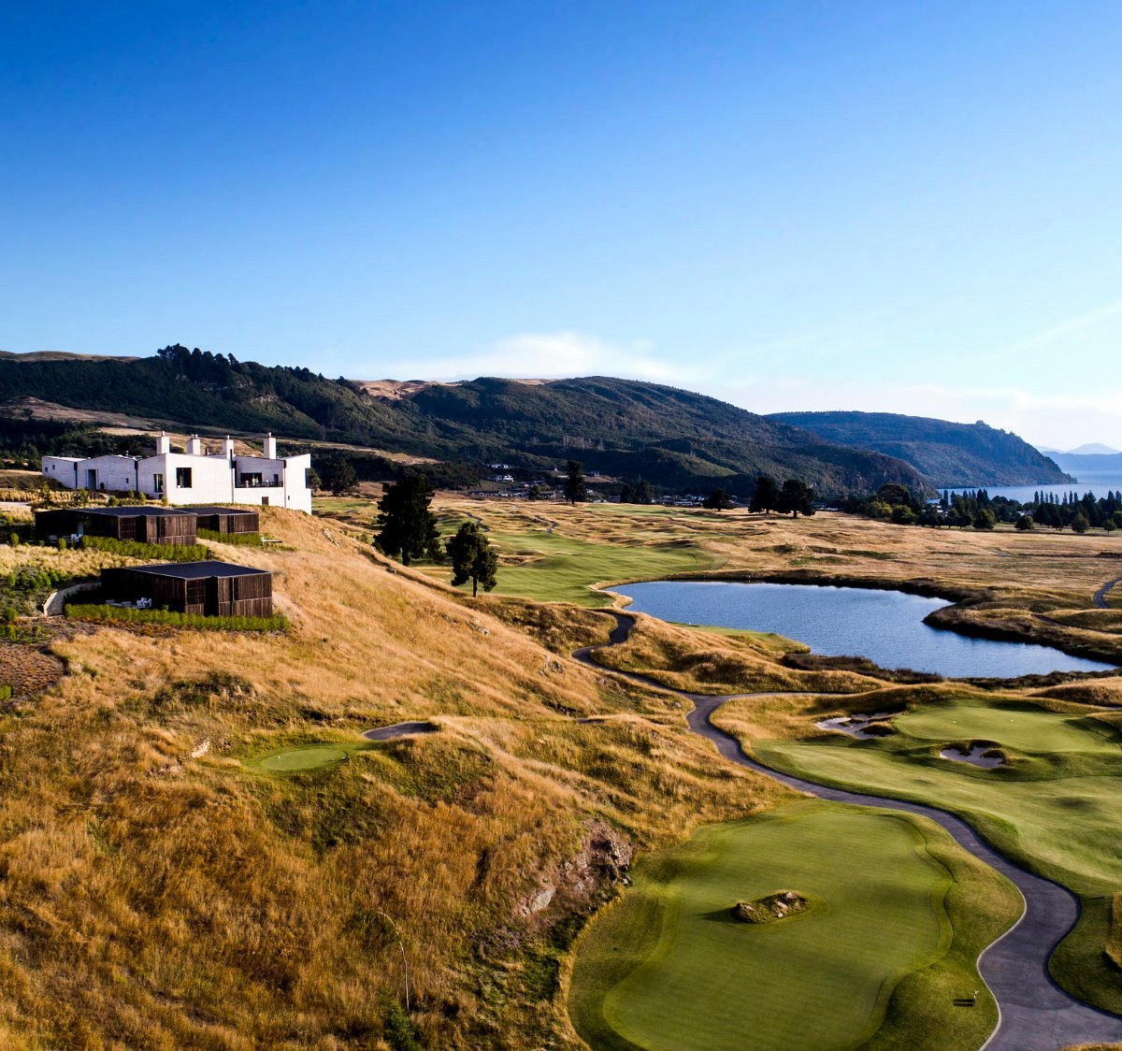
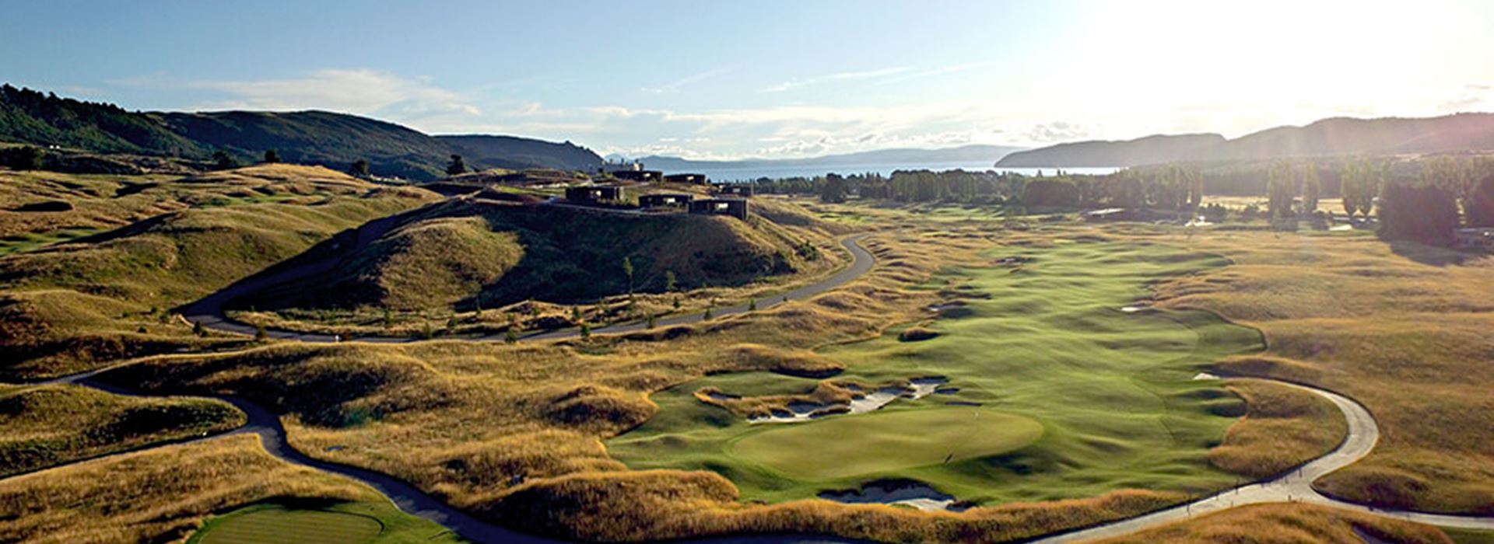
SUNDAY 9TH FEBRUARY
Practise round at Kinloch followed by the Official Welcome Dinner
MONDAY 10TH FEBRUARY
Opening round hosted at Kinloch
TUESDAY 11TH FEBRUARY
Round 2 at Wairakei Golf and Sanctuary

Slide 7
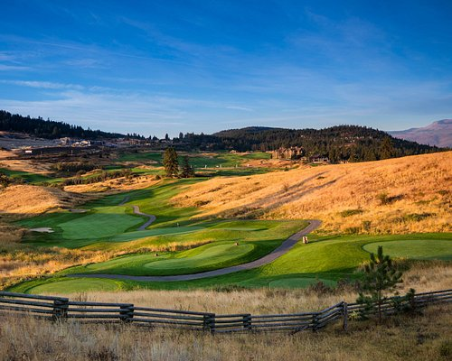
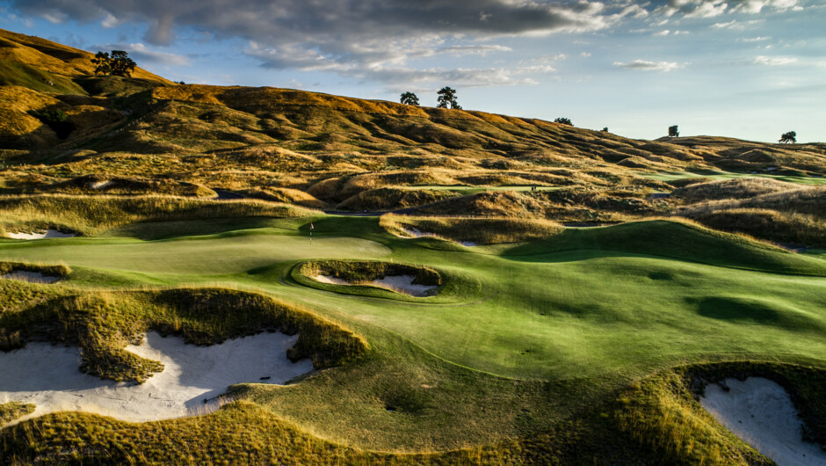
WEDNESDAY 12TH FEBRUARY
Round 3 at Wairakei Golf and Sanctuary
THURSDAY 13TH FEBRUARY
Closing round hosted at Wairakei Golf and Sanctuary
FRIDAY 14TH FEBRUARY
Head back to Auckland with a stop at the airport or onward tour.

